Slide 1
POV, HMW, Experience Prototypes
Stethoscope Digitization
Health Domain

Slide 2


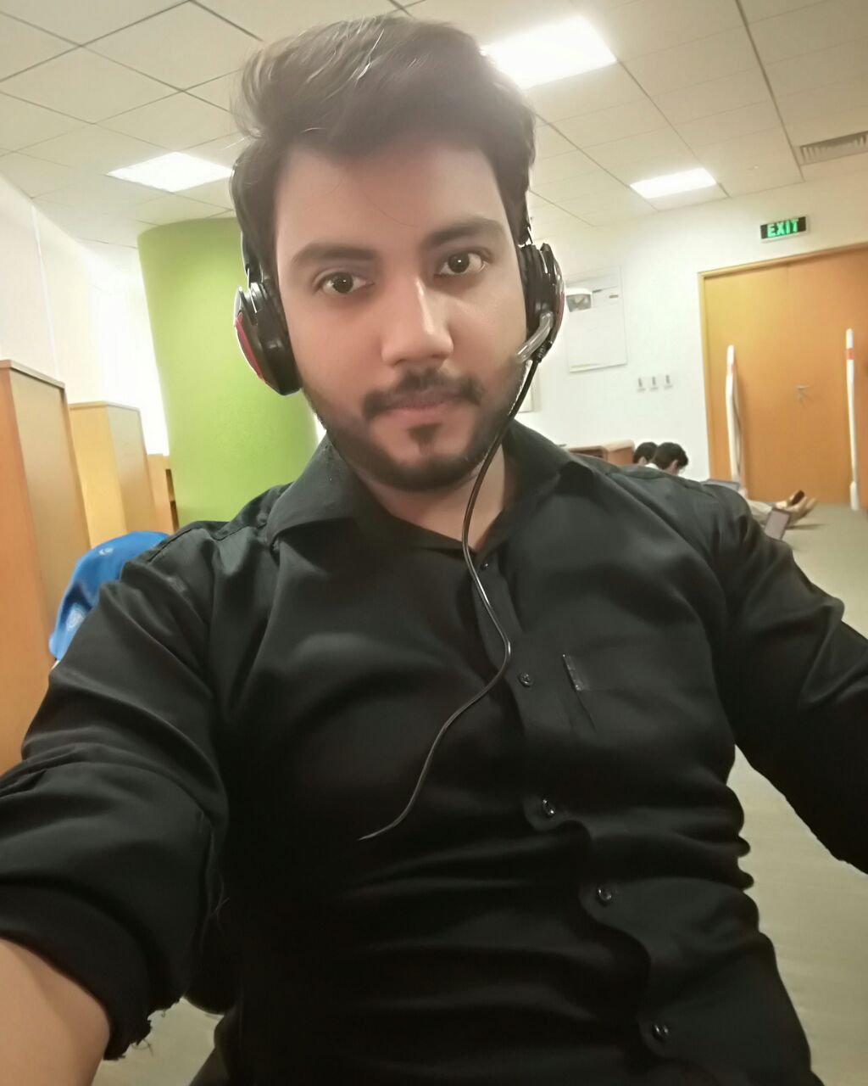

Team
Aaira Suhail Sheryar Zahid Iqra Shahzad Syed M. Hassan

Slide 3
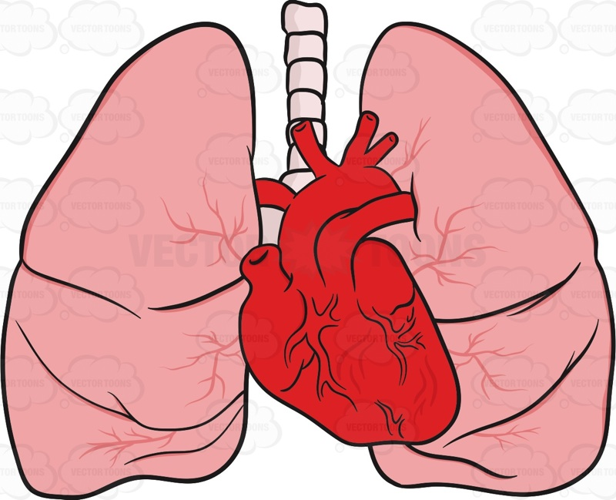

Initial Point of view
It would be game changing to differentiate between different sounds of heart and respiration

Slide 4

It would be game changing to help the doctors through technology and gain their confidence
It would be game changing if we reduce the diagnosis time.

Slide 5
Interviews
We met Dr Usman he doesn’t actually need any device but he wants a device that can help patients. As they will be able to detect pneumonia at home.
It will be game changing to make an application through which patients can detect pneumonia themselves.

Slide 6
We met Dr Ayesha in Ittefaq Hospital she also said that she is used to detect pneumonia through the test and auscultation and if we make any device it might not be helpful for the doctors but it might help the patients.

Slide 7
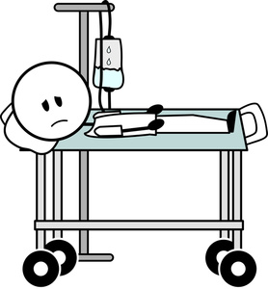


Needfinding Discoveries:
Patients need aid
Doctors want
A trusted mechanism

Slide 8
Revised POV’s: Saba
Final year student
Cannot distinguish between alike sounds
Finds it time consuming
We could help her save her time and hear sounds clealry

Slide 9

Revised POV’s: Dr Usman
Child Specialist
Want a patients end aid
Is used to diagnosis through traditonal method
We can help patients in diagnosis

Slide 10
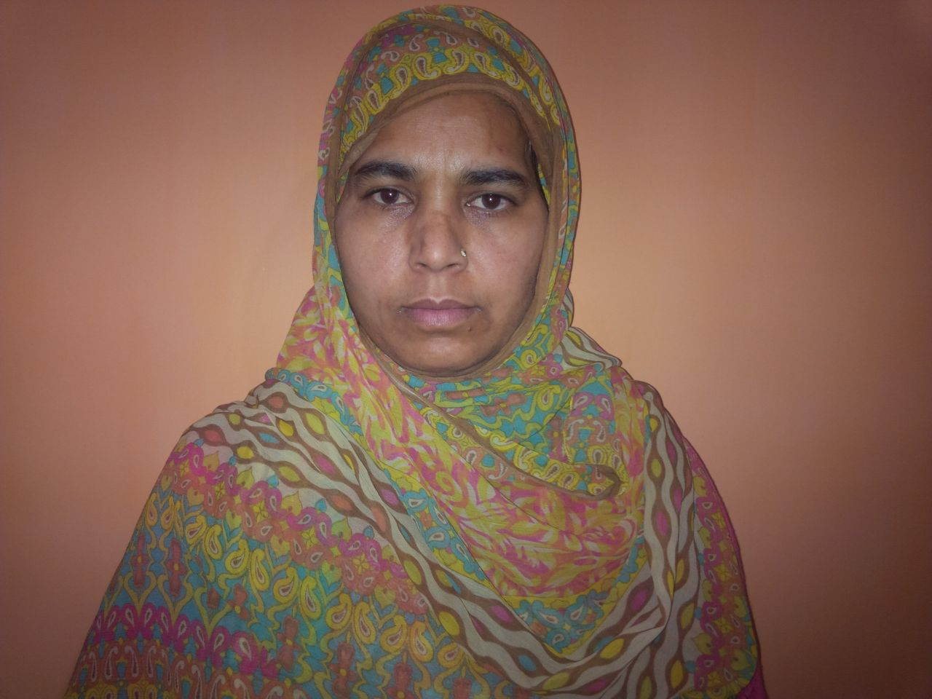
Revised POV’s: Azra bibi
Mother of pneumonia suffering patient
Wants to save rides to doctors
We can help her deal with after detection phases of pnenomia

Slide 11
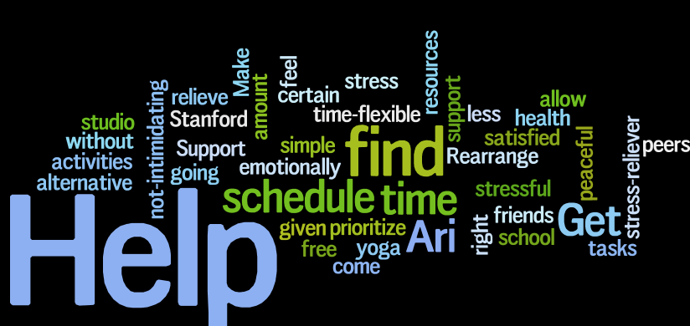
How Might We.. (Saba)
How might we help differentiate between sounds and save time?

Slide 12
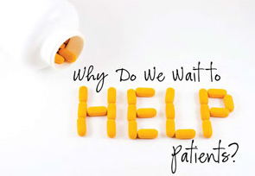
How Might We.. (Dr. Usman)
How might we help the patients to diagnose pneumonia at their homes?

Slide 13

How Might We.. (Azra bibi)
How might we help her reduce her visits to the doctor?

Slide 14
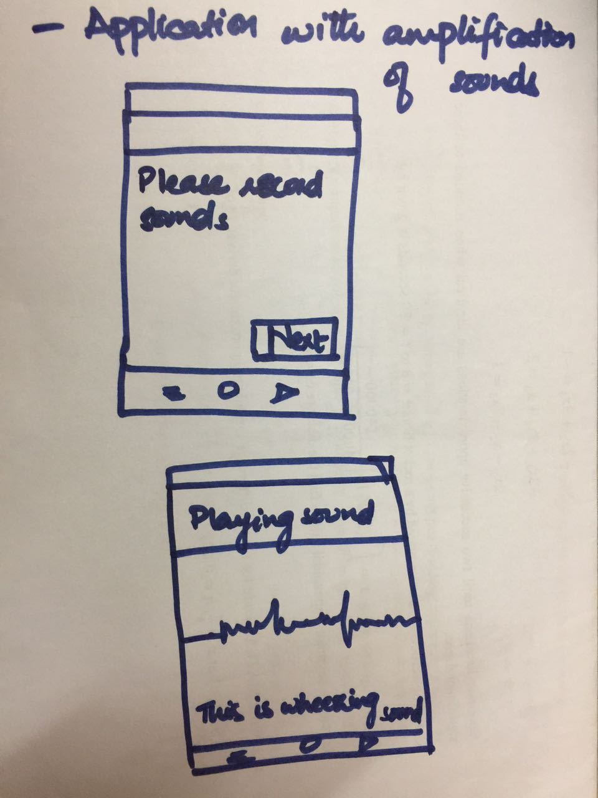
Experience Prototype 1
Lets hear the sounds cleary and tells what sound is being played
Assumptions: Will aid in learning
Learning: Voice detection is not enough
Learning: More factors should be included

Slide 15
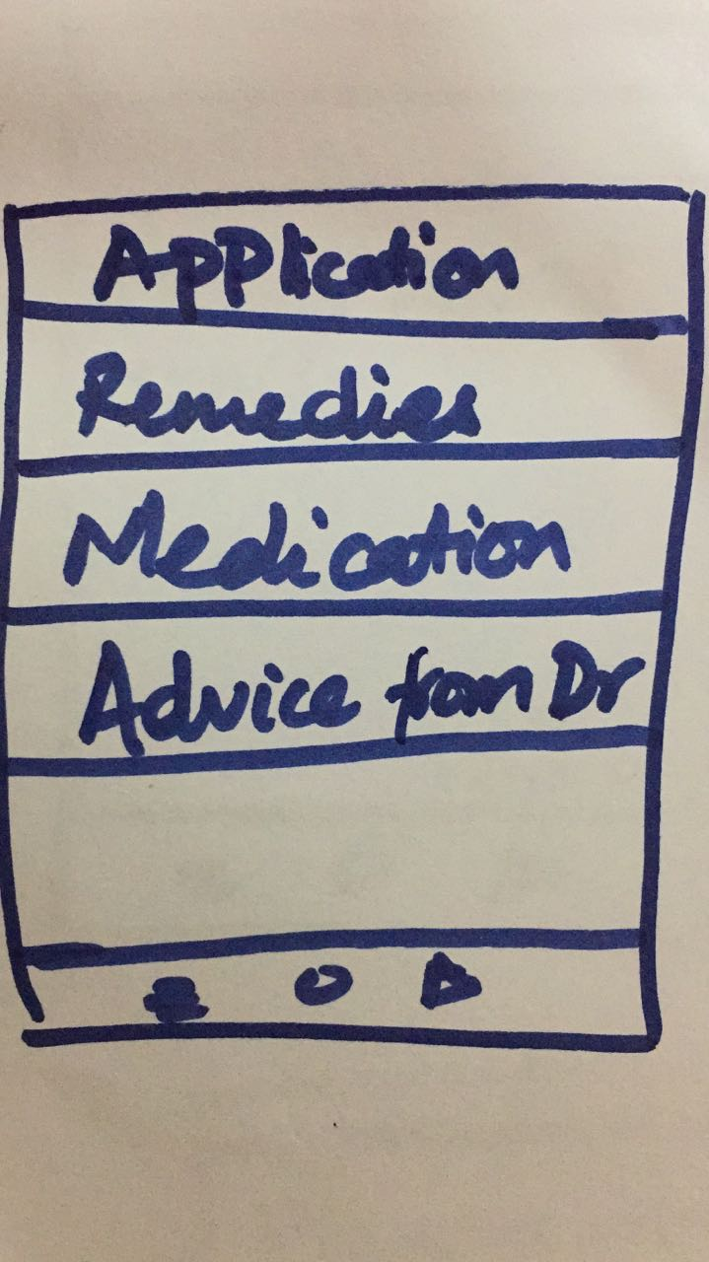
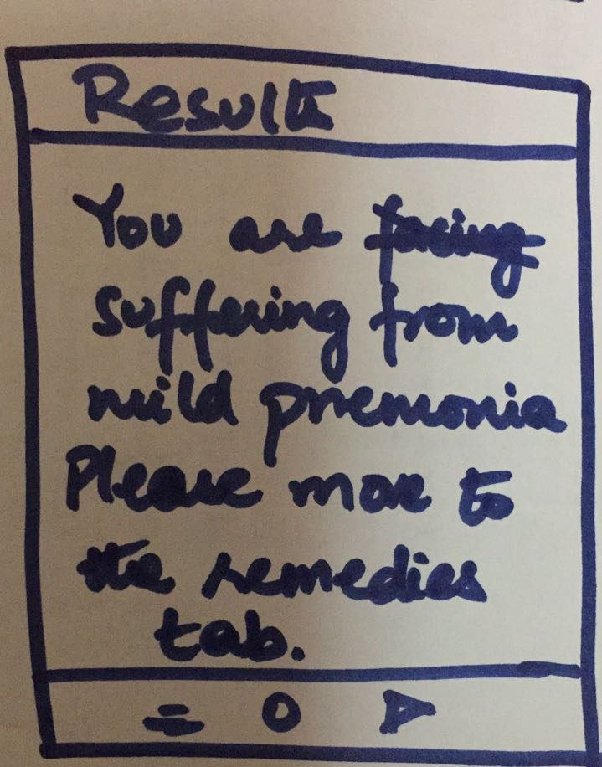
Experience Prototype: Remedies App
Gives expert doctors advice, home remedies and medication
Assume: Patients would find it convincing
Learning: Patients got confused while the selection of medicine
Learn: Home remedies proved an effective part

Slide 16
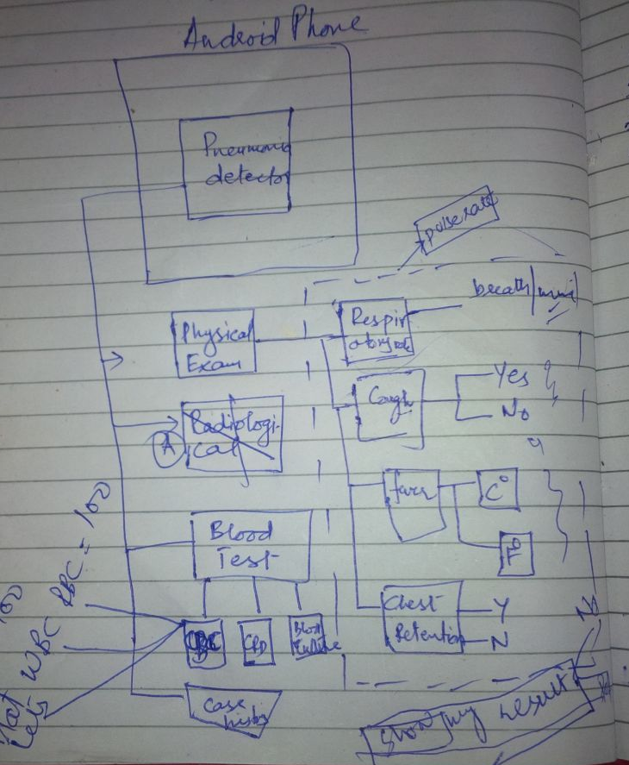
Experience Prototype 3
Checks all the possibiltes for the detection of pneumonia by patient himself
Assume: Litertate patients and have the reports of blood tests
Learn: Severe pneumonia cannot be detected
Learn: Should be bilingual

Slide 17
Thanks! :)

